Slide 1
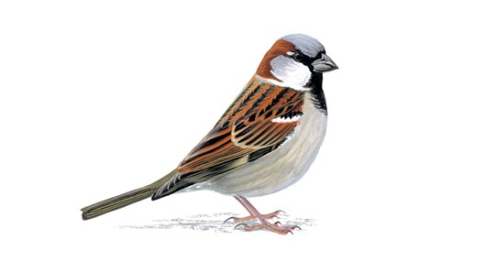

Slide 2
House

Slide 3
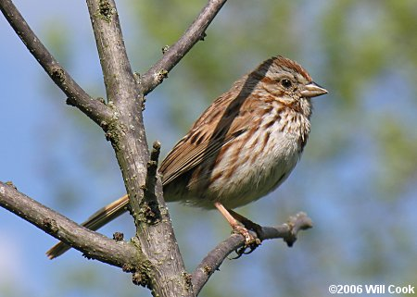

Slide 4
Song

Slide 5
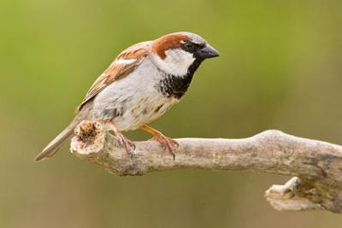

Slide 6
House

Slide 7
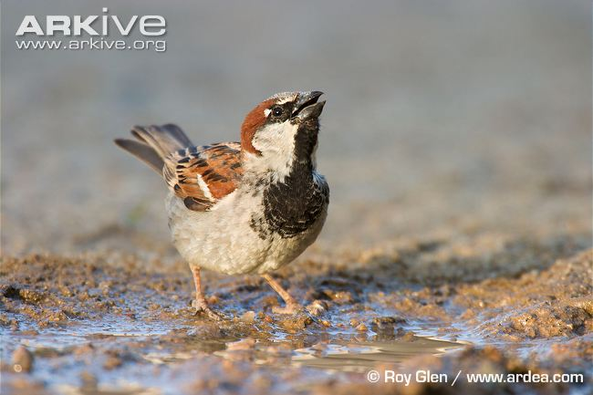

Slide 8
House

Slide 9
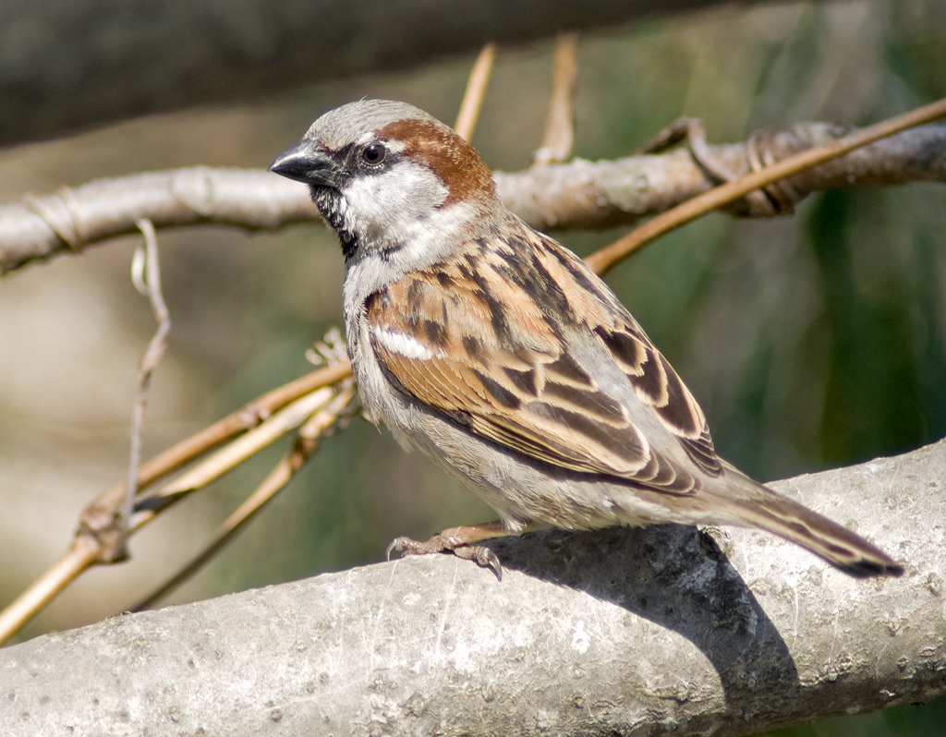

Slide 10
House

Slide 11
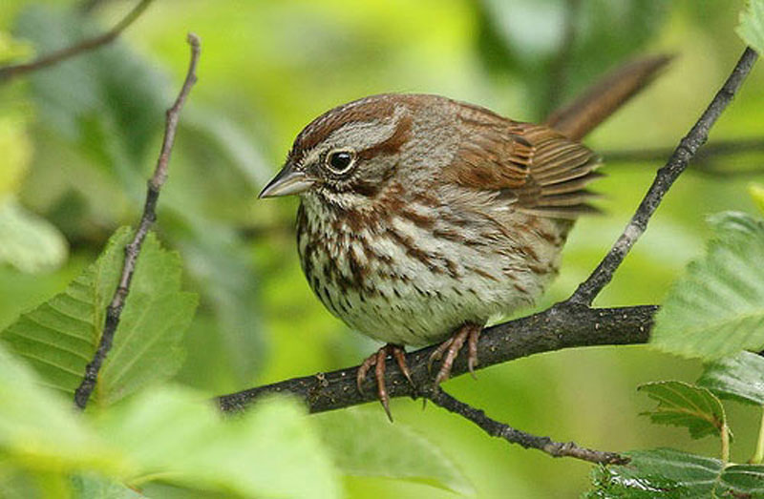

Slide 12
Song

Slide 13
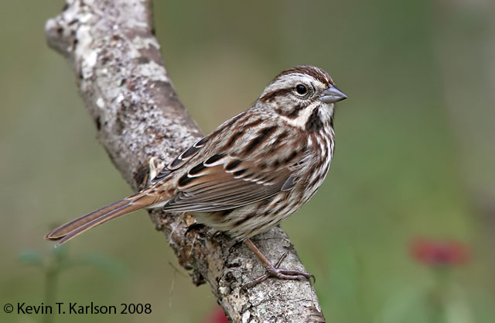

Slide 14
Song

Slide 15
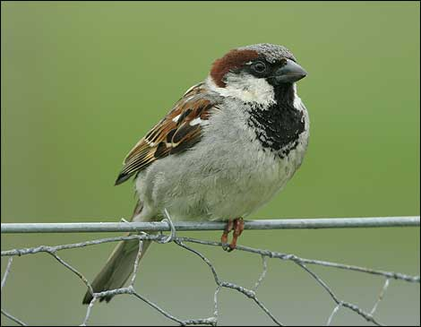

Slide 16
House

Slide 17
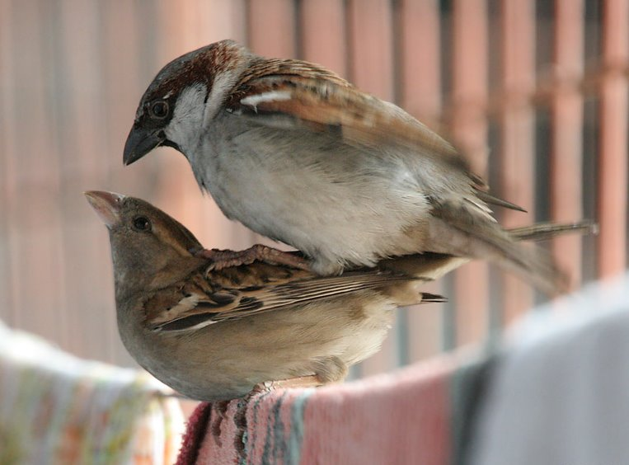

Slide 18
House

Slide 19
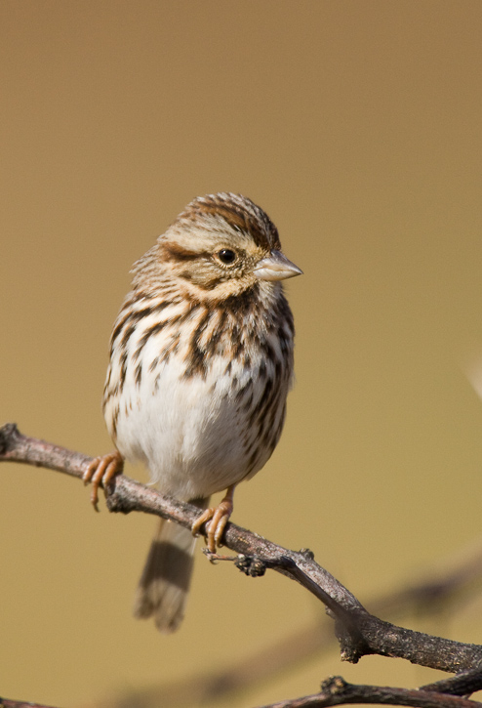

Slide 20
Song

Slide 21
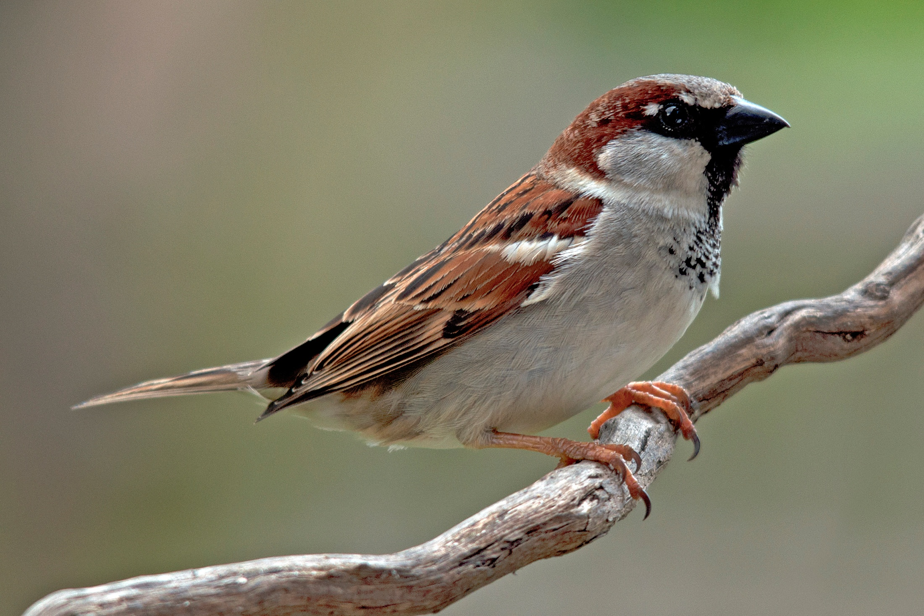

Slide 22
House

Slide 23
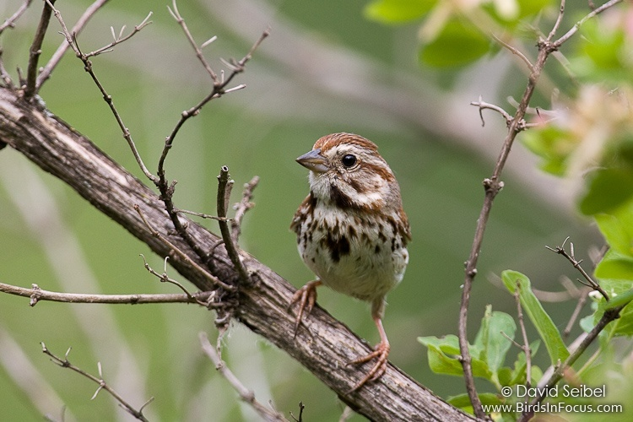

Slide 24
Song

Slide 25
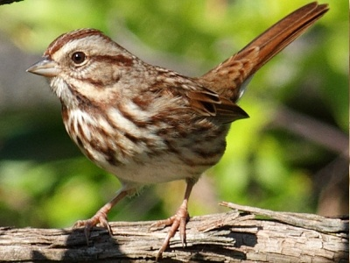

Slide 26
Song

Slide 27
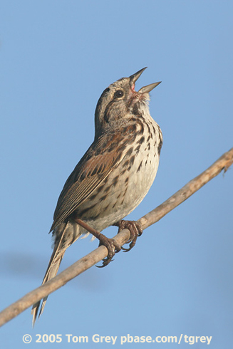

Slide 28
Song

Slide 29
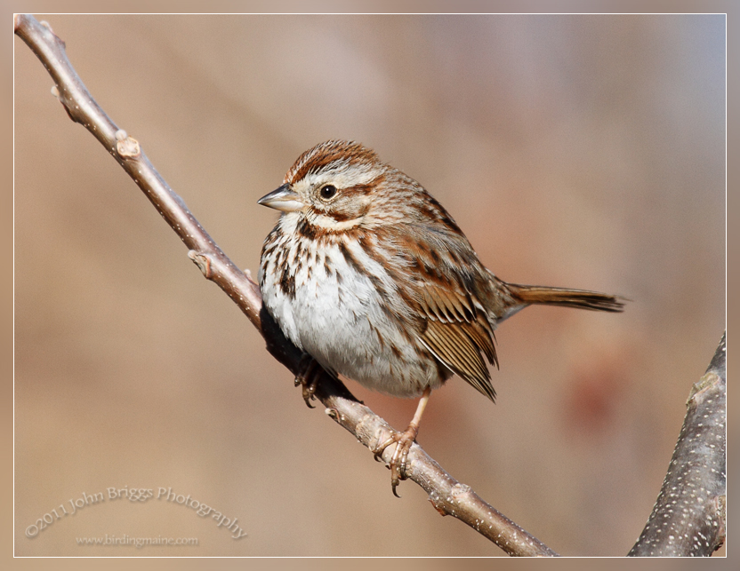

Slide 30
Song

Slide 31
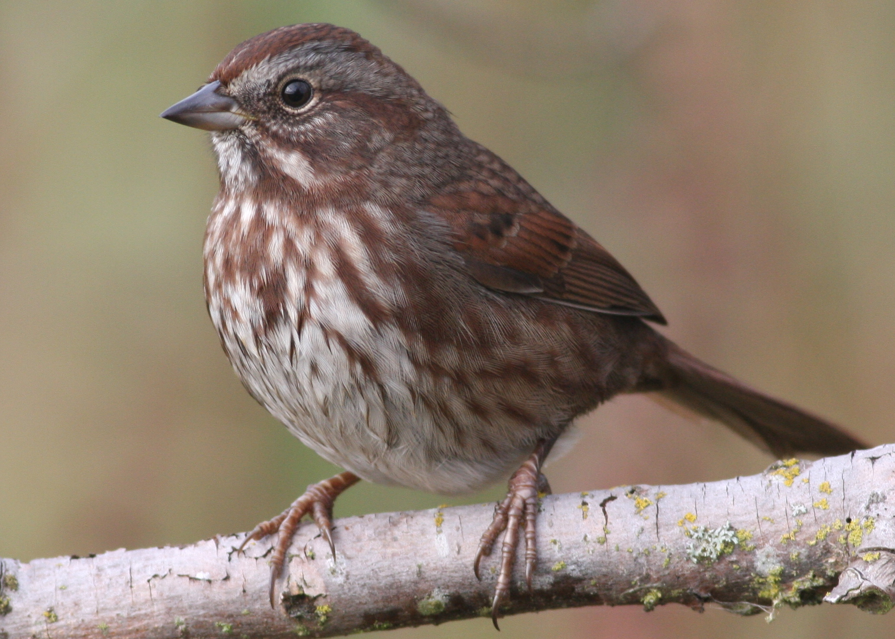

Slide 32
Song

Slide 33
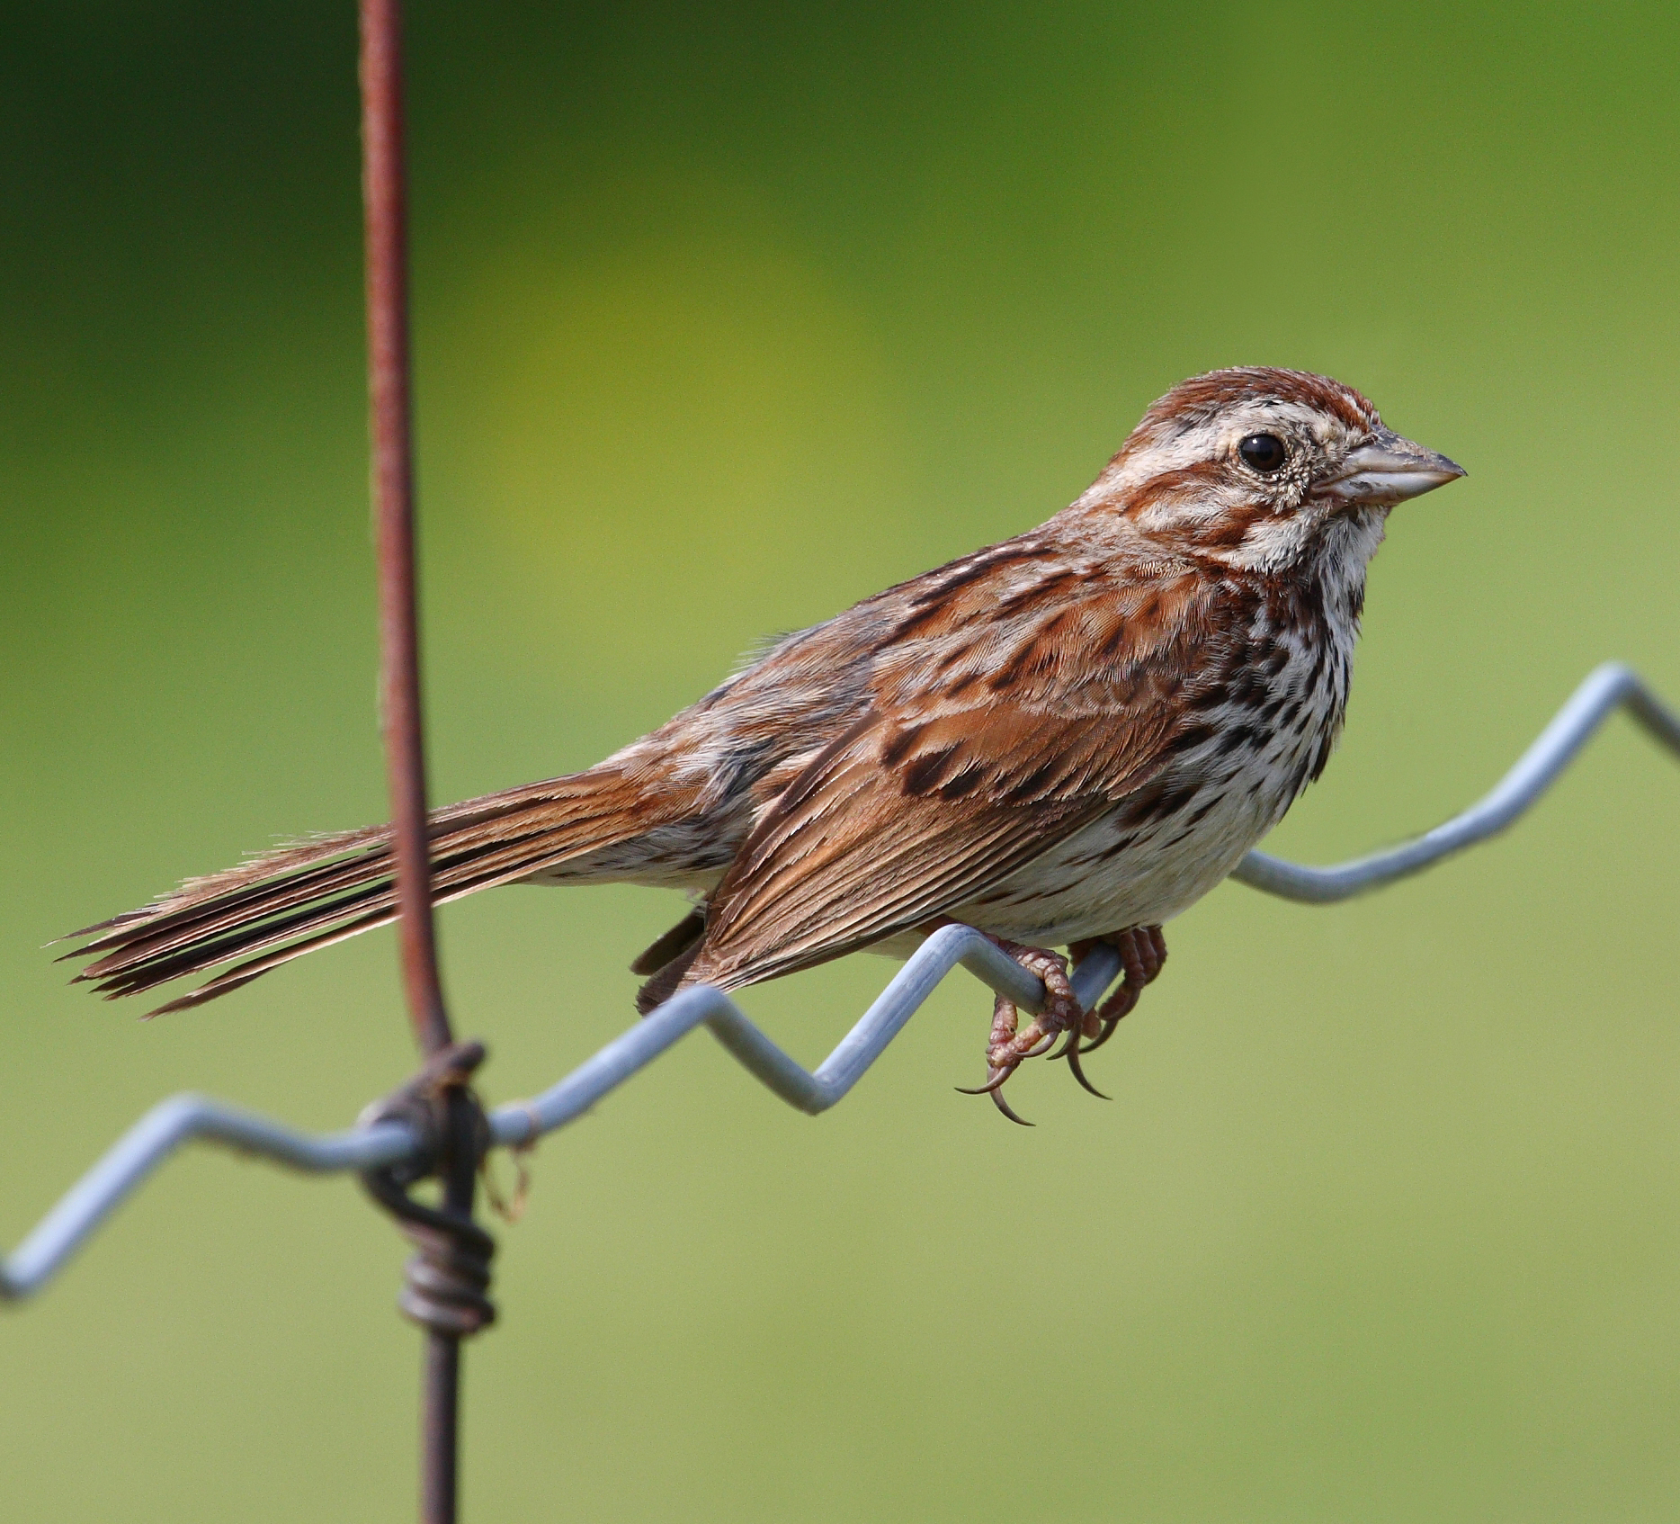

Slide 34
Song

Slide 35
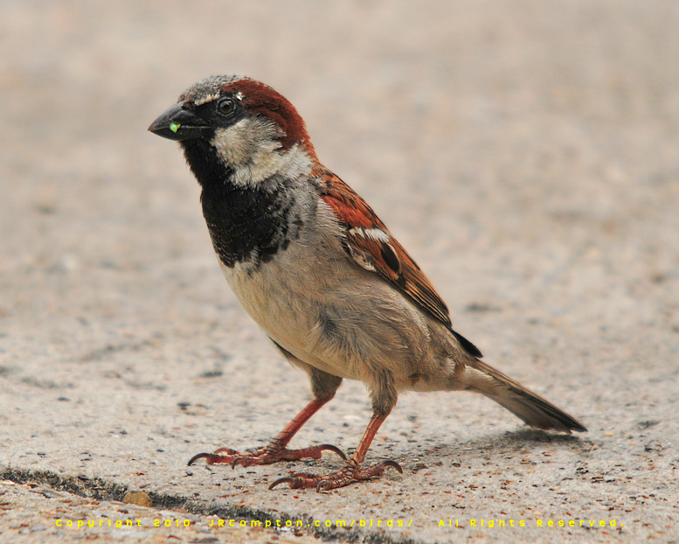

Slide 36
House

Slide 37
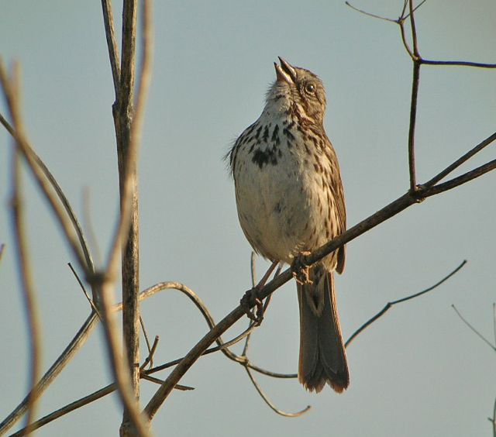

Slide 38
Song

Slide 39
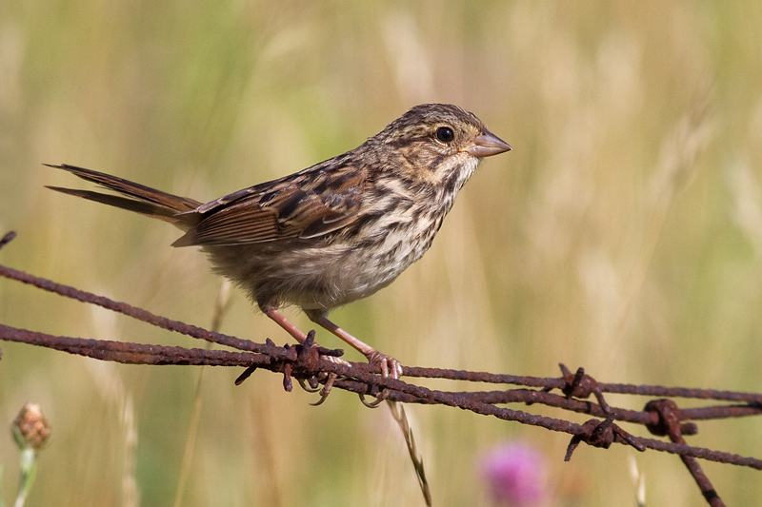

Slide 40
Song

Slide 41
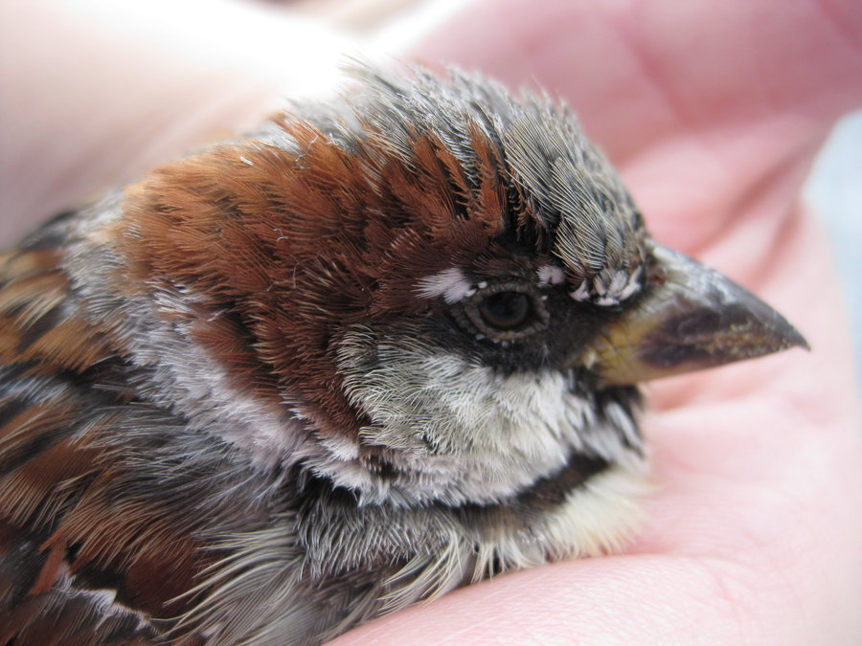

Slide 42
House

Slide 43
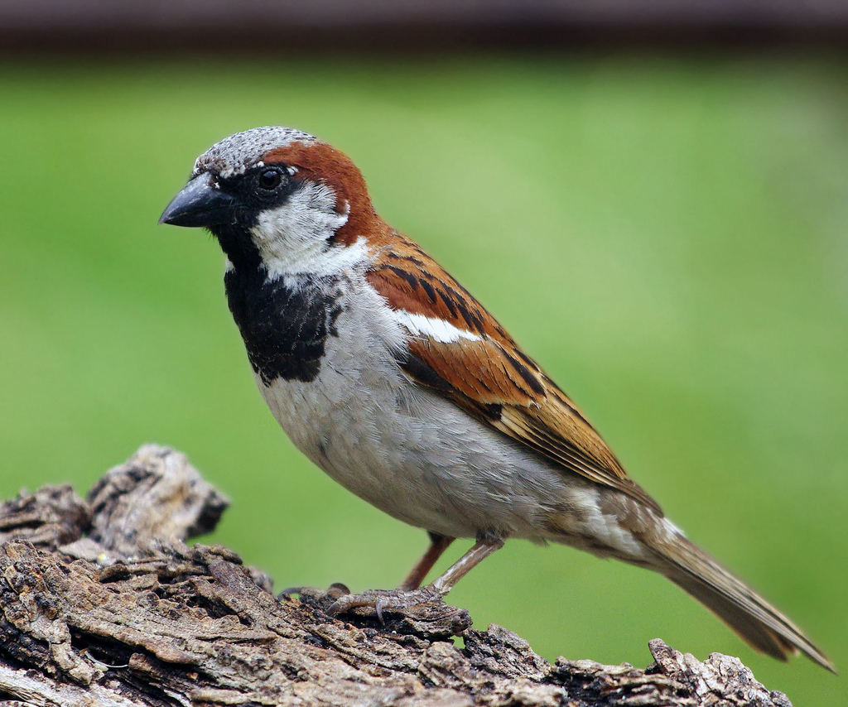

Slide 44
House

Slide 45
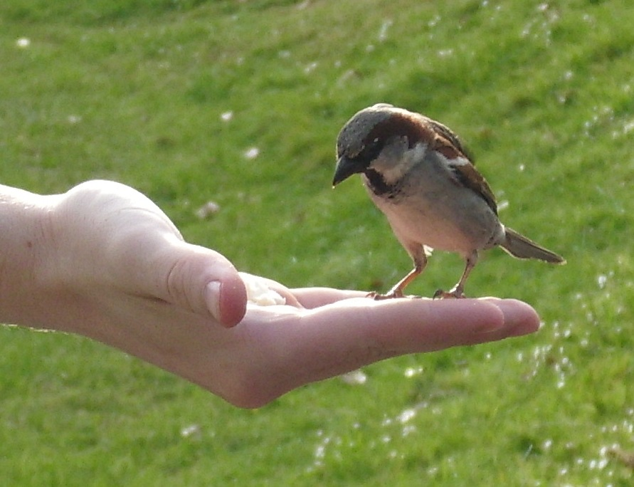

Slide 46
House

Slide 47
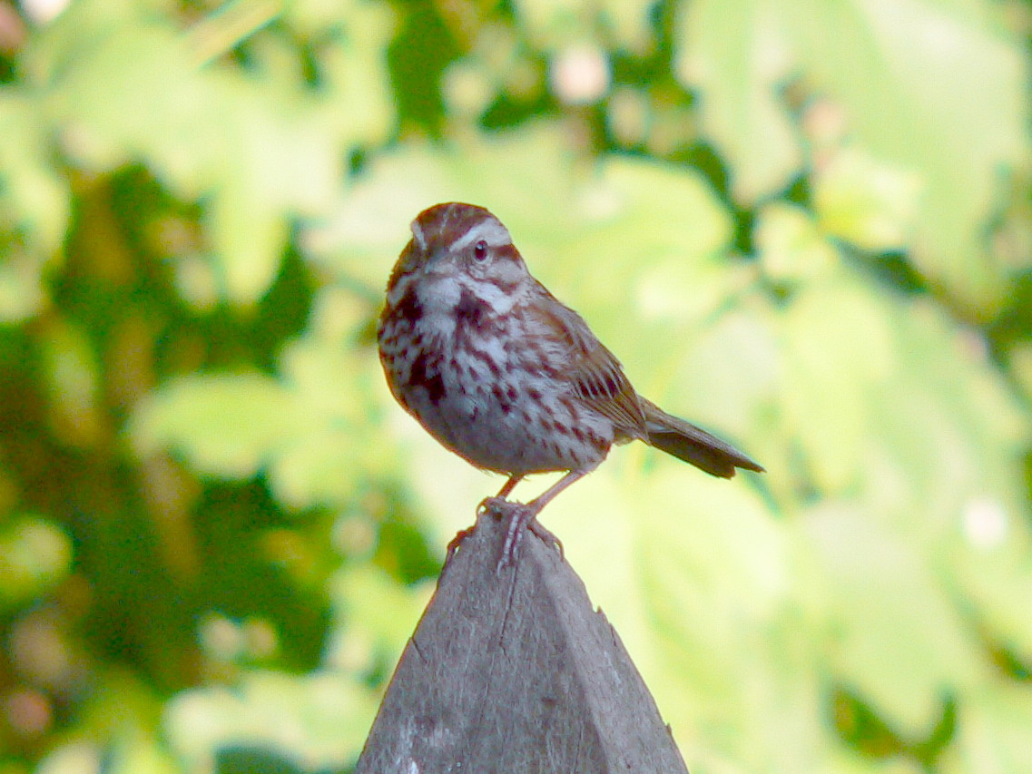

Slide 48
Song

Slide 49
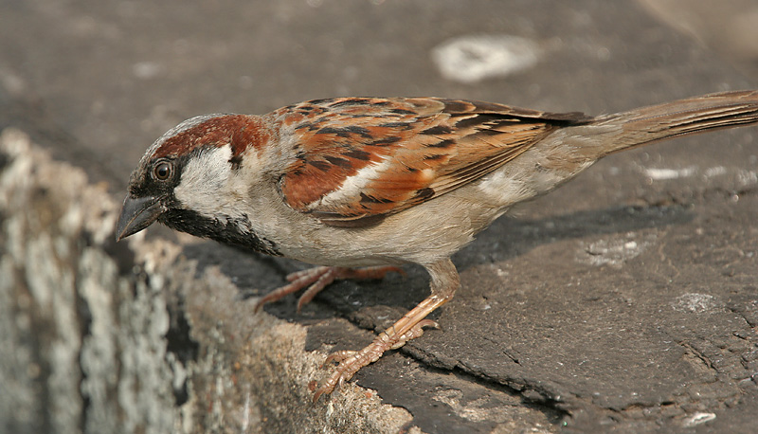

Slide 50
House

Slide 51
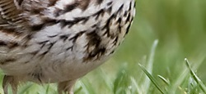

Slide 52
Song

Slide 53
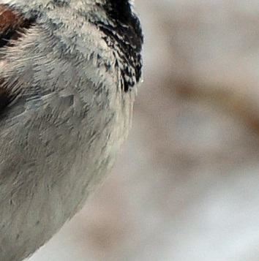

Slide 54
House

Slide 55
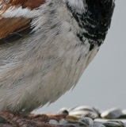

Slide 56
House

Slide 57
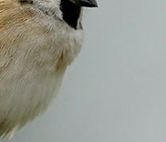

Slide 58
House

Slide 59
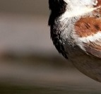

Slide 60
House

Slide 61
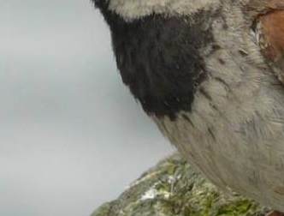

Slide 62
House

Slide 63
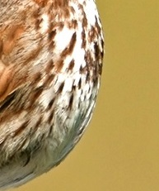

Slide 64
Song

Slide 65
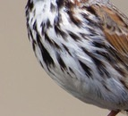

Slide 66
Song

Slide 67
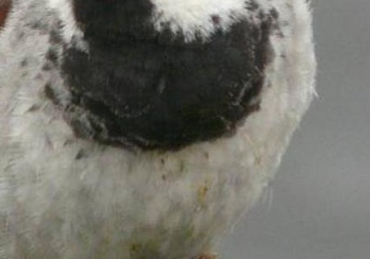

Slide 68
House

Slide 69
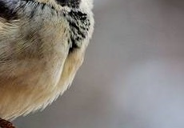

Slide 70
House

Slide 71
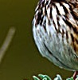

Slide 72
Song

Slide 73
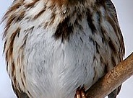

Slide 74
Song

Slide 75
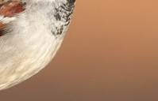

Slide 76
House

Slide 77
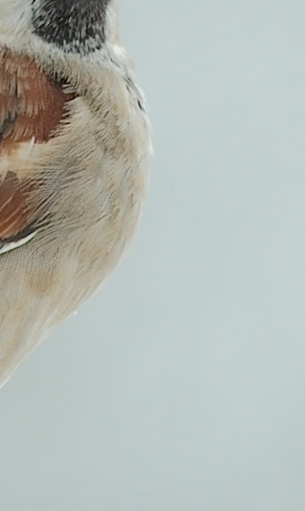

Slide 78
House

Slide 79
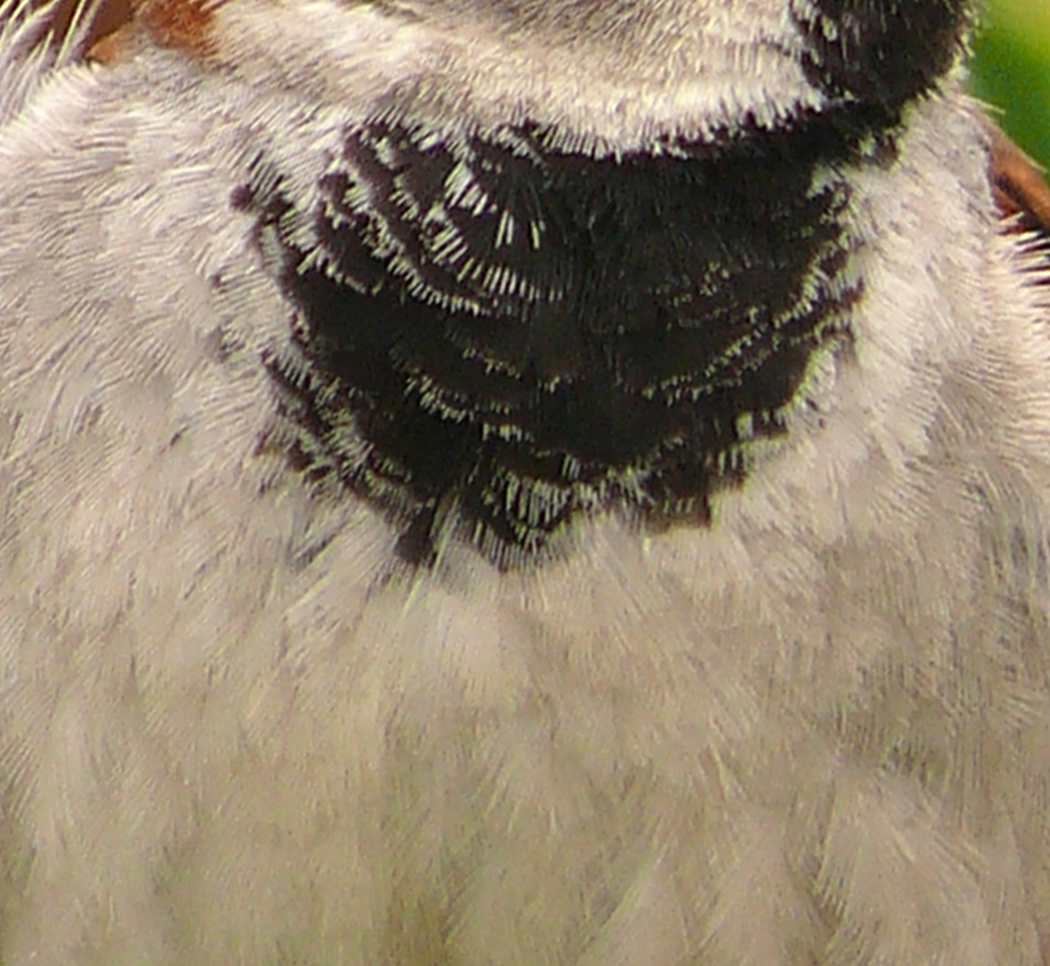

Slide 80
House

Slide 81
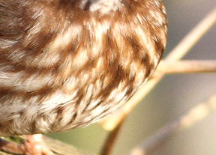

Slide 82
Song

Slide 83
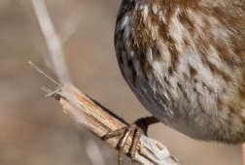

Slide 84
Song

Slide 85
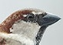

Slide 86
House

Slide 87
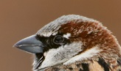

Slide 88
House

Slide 89
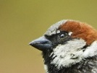

Slide 90
House

Slide 91
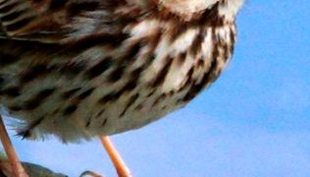

Slide 92
Song

Slide 93
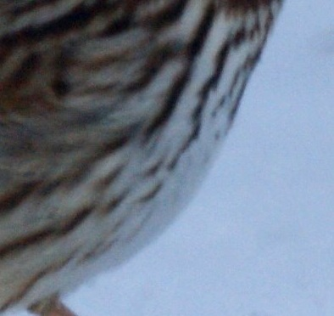

Slide 94
Song

Slide 95
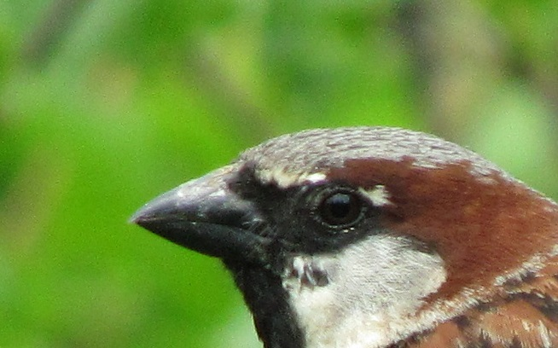

Slide 96
House

Slide 97
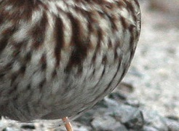

Slide 98
Song

Slide 99
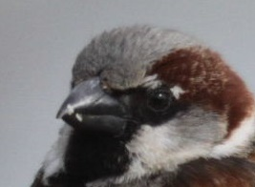

Slide 100
House

Slide 101


Slide 102
House

Slide 103


Slide 104
House

Slide 105


Slide 106
House

Slide 107


Slide 108
Song

Slide 109


Slide 110
House

Slide 111


Slide 112
Song

Slide 113


Slide 114
House

Slide 115


Slide 116
House

Slide 117


Slide 118
Song

Slide 119


Slide 120
House

Slide 121


Slide 122
Song

Slide 123


Slide 124
Song

Slide 125


Slide 126
Song

Slide 127


Slide 128
Song

Slide 129


Slide 130
Song

Slide 131


Slide 132
House

Slide 133


Slide 134
Song

Slide 135


Slide 136
House

Slide 137


Slide 138
Song

Slide 139


Slide 140
Song

Slide 141


Slide 142
Song

Slide 143


Slide 144
House

Slide 145


Slide 146
Song

Slide 147


Slide 148
Song

Slide 149


Slide 150
Song

Slide 151


Slide 152
Song

Slide 153


Slide 154
House

Slide 155


Slide 156
House

Slide 157


Slide 158
House

Slide 159


Slide 160
Song

Slide 161


Slide 162
Song

Slide 163


Slide 164
Song

Slide 165


Slide 166
House

Slide 167


Slide 168
Song

Slide 169


Slide 170
Song

Slide 171


Slide 172
Song

Slide 173


Slide 174
Song

Slide 175


Slide 176
Song

Slide 177


Slide 178
House

Slide 179


Slide 180
House

Slide 181


Slide 182
Song

Slide 183


Slide 184
House

Slide 185


Slide 186
House

Slide 187


Slide 188
House

Slide 189


Slide 190
House

Slide 191


Slide 192
House

Slide 193


Slide 194
House

Slide 195


Slide 196
House

Slide 197


Slide 198
House

Slide 199


Slide 200
House

Slide 201


Slide 202
House

